Slide 1
Physical Chemistry
Ying Hu
(Fifth edition)
Bilingual Program
版权所有：华东理工大学物理化学教研室

Slide 2
Part IV Statistics
Chapter 12 Statistical Mechanics of Independent Particle Systems
Bilingual Program
版权所有：华东理工大学物理化学教研室

Slide 3
Framework of the Chapter
General principles of equilibrium at the transition level
from microscopic to macroscopic
I. Principles of Statistical Mechanics
II. Statistical Distributions of Independent Particle Systems
III. Thermodynamic Properties of Independent-Particle Systems
Description of Microscopic States
Thermodynamic Functions
Maxwell-Boltzmann Distribution
  Standard Heat Capacity of Gases
Fundamental Postulates of Statistical Mechanics
  Standard Entropy of Gases
The Most Probable Distribution
  Molecular Partition Function
  Heat Capacity of Crystals
  Standard Equilibrium Constant

Slide 4
12.1 Introduction
Statistical mechanics is to obtain macroscopic properties from the corresponding microscopic properties of particle movement by statistical averaging.
Macroscopic systems composed of a large number of microscopic particles.
Independent-Particle System
Non-Localized-Particle System
Dependent-Particle System
Localized-Particle System

Slide 5
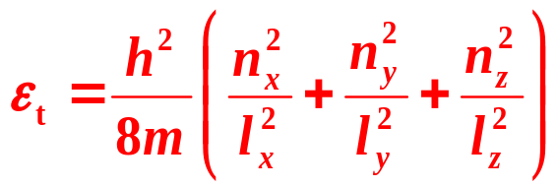
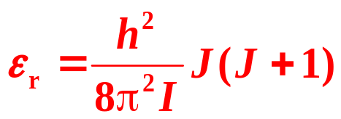
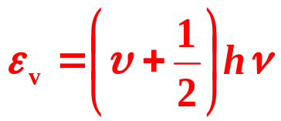






12.2 Description of Microscopic States
Energy levels (Planck constant h = 0.66260755×10⁻³³J s)
 | Translation | Rotation | Vibration
Energy level
Quantum numbers
Energy spacing
Degeneracy | Depending on the energy level | 2J+1 | none
Δ
Δ
Δ
k, Boltzmann constant, 13.80658×10⁻²⁴J⋅K⁻¹

Slide 6
  12.3 Fundamental Postulates of Statistical Mechanics
Three fundamental postulates
1
A macroscopic state corresponds to a certain generally a large number of microscopic states, each of them appears in terms of a certain probability.
2
A macroscopic mechanical quantity is the statistical average of the corresponding microscopic quantities.
3
For every one of the microscopic states in an isolated system, they have identical probabilities of appearance.

Slide 7
  12.3 Fundamental Postulates of Statistical Mechanics
2. The Second Postulate:
A macroscopic mechanical quantity is the statistical average of the corresponding microscopic quantities.
Mechanical Quantities and Non-Mechanical Quantities
Mechanical quantities, have corresponding microscopic properties at molecular level. These quantities include energy, density, pressure.
Non-mechanical quantities, do not have corresponding microscopic properties. These quantities include temperature, entropy, Gibbs function, chemical potential.

Slide 8
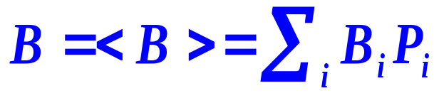
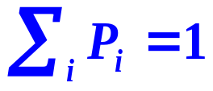
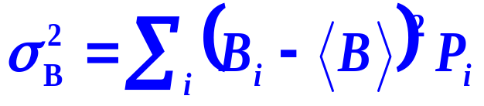
  12.3 Fundamental Postulates of Statistical Mechanics
Mathematical Expression of the Second Postulate
B, mechanical quantity
B_{i}, microscopic quantity
i, microscopic state
P_{i}, the probability
< >, the statistical average
Fluctuations about the Average
The microscopic quantity B_{i} of the mechanical quantity B does not equal <B> , but fluctuates around it.

Slide 9
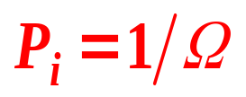
  12.3 Fundamental Postulates of Statistical Mechanics
3. The Third Postulate:
Every one of the microscopic states in an isolated system has an identical probability of appearance.
Postulate of equal a priori probabilities
In the case of molecules completely isolated from the external influences, any microscopic state will not appear preferentially (a priori).
N, E and V are kept unchanged, Ω is the total number of the microscopic states for a macroscopic state,

Slide 10
Framework of the Chapter
I. Principles of Statistical Mechanics
  12.2 Description of Microscopic States
  12.3 Fundamental Postulates of Statistical Mechanics
  12.4 The Most Probable Distribution

Slide 11
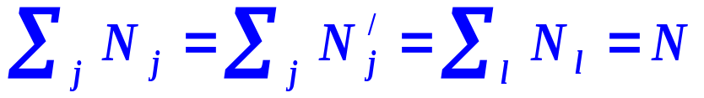
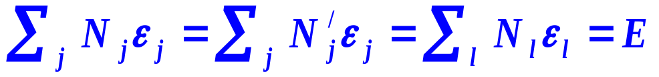
  12.4 The Most Probable Distribution
1. Distributions in Independent-Particle Systems
In terms of Energy Levels
A distribution of molecules on energy levels with serial numbers i
Energy level ε₀, ε₁, ε₂, …
Degeneracy g₀, g₁, g₂, …
Number of molecules N₀, N₁, N₂, …
N₀’, N₁’, N₂’, …
Constrains
Conservation of particle
Conservation of energy
Identical average energies

Slide 12
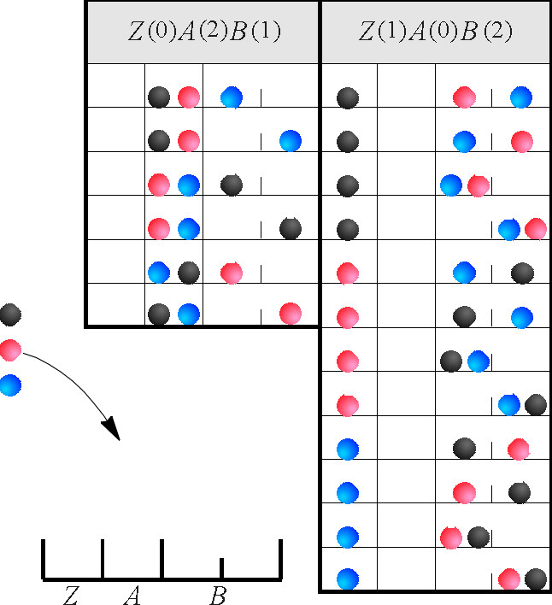
  12.4 The Most Probable Distribution
2. Relations among Macroscopic State, Distributions and
Microscopic States
A Simplified Example
Macroscopic State
N=3, E=4
Microscopic State
Energy level ：Z=0， A=1， B=2
Degeneracy ： g_{z}=1，g_{A}=1，g_{B}=2
Number of molecules
0， 2， 1
1， 0， 2
Distribution
Z(0)A(2)B(1); Z(1)A(0)B(2)

Slide 13
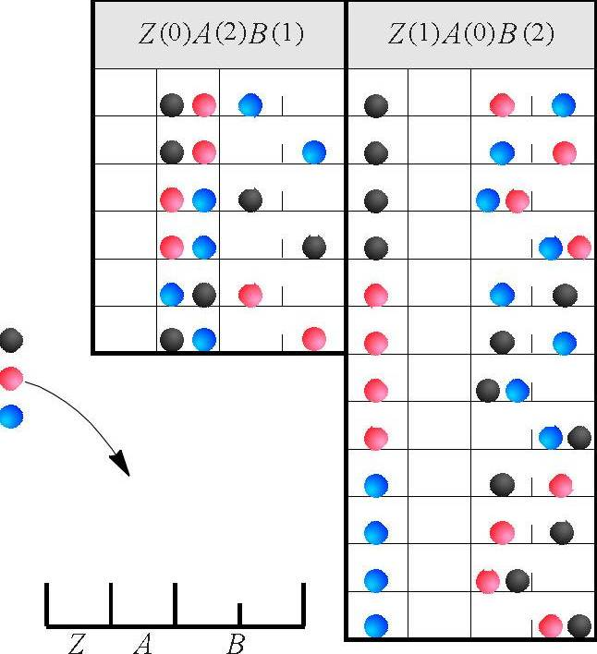
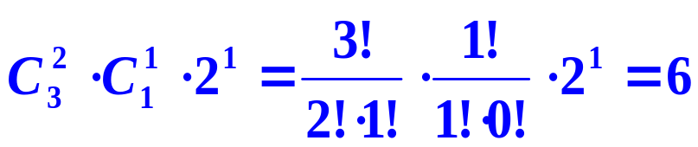
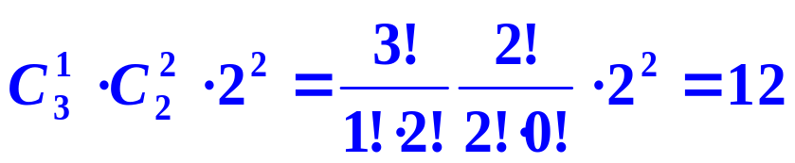


  12.4 The Most Probable Distribution
Calculations for the Number of Microscopic States, ω
Z(0)A(2)B(1)：
Z(1)A(0)B(2)：
The number of all probable microscopic states, Ω , is 18
The probability
Z(0)A(2)B(1)
Z(1)A(0)B(2)

Slide 14
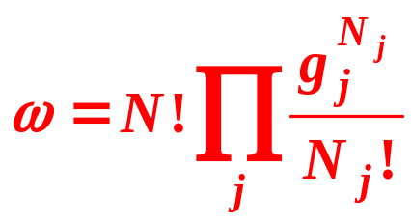
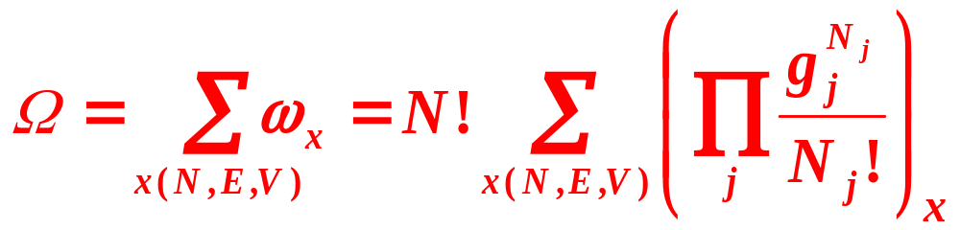
  12.4 The Most Probable Distribution
Arbitrary Distributions in terms of Energy Levels
Energy level ε₀, ε₁, ε₂, …
Degeneracy g₀, g₁, g₂, …
Number of molecules N₀, N₁, N₂, …
The number of microscopic states
A Macroscopic State with Fixed N, E, and V
The total number of microscopic states Ω

Slide 15
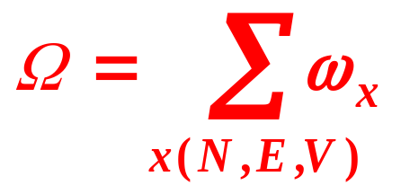
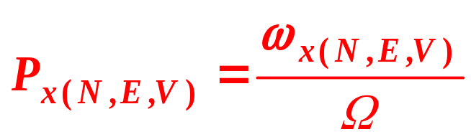
  12.4 The Most Probable Distribution
3. Thermodynamic Probability
Thermodynamic Probability
The number of microscopic states ω possessed by a distribution x(N,E,V).
The number of total microscopic states Ω possessed by a macroscopic state.
Probability
Probability P_{x(N,E,V)}

Slide 16
  12.4 The Most Probable Distribution
3. Thermodynamic Probability
For a macroscopic state, it is possible to have various distributions (configurations).
Each distribution contains a certain number of microscopic states, ω.
A macroscopic state covers a fixed number of microscopic states, Ω.

Slide 17

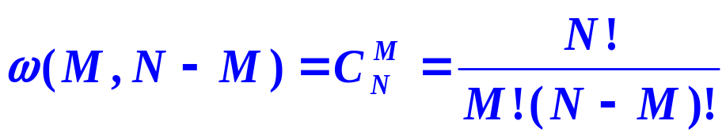
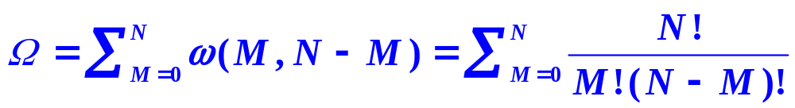
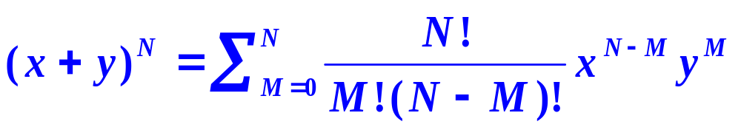

  12.4 The Most Probable Distribution
4. The Most Probable Distribution
Demonstration
distinguishable balls have distributions
A₀B_{N}, A₁B_{N-1}, ······ A_{N-1}B₁, A_{N}B₀
A
B
①
Binomial formula,

Slide 18
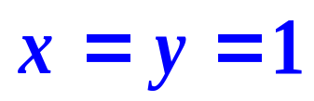
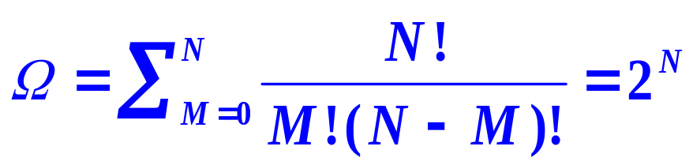

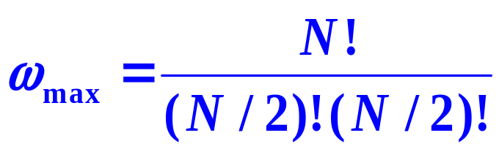
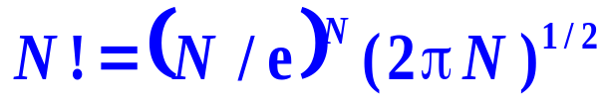
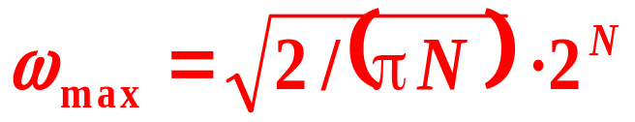
  12.4 The Most Probable Distribution
Binomial formula,
②
The maximum binomial factor
Stirling
Maximum Thermodynamic Probability ω_{max} of the Most Probable Distribution
③

Slide 19
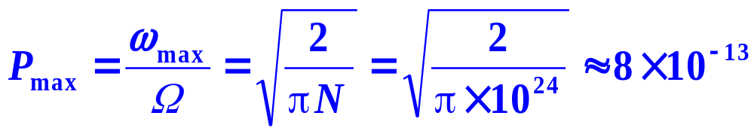
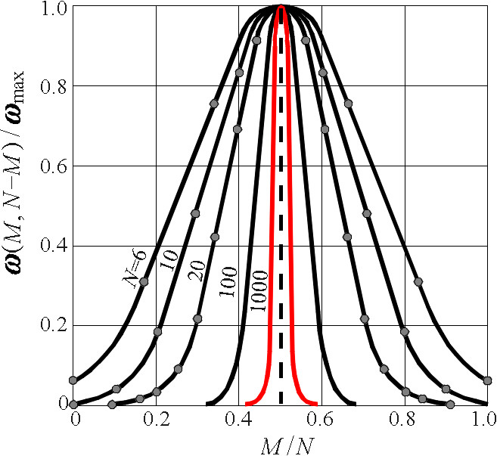
  12.4 The Most Probable Distribution
④
Maximum Probability P_{max} of the Most Probable Distribution
⑤
the Fluctuation of the Number of Particles
The numbers of particles of different distributions are fluctuated;
For the system with a large number of particles, the difference can not be detected completely on the macroscopic level;
The distributions in the range of 2×10¹²-0.5×10²⁴ are essentially the same as the most probable distribution, and the sum of those is virtually 1.

Slide 20
  12.4 The Most Probable Distribution
4. The Most Probable Distribution
Definition
The distribution possessing the largest number of microscopic states or with the maximum thermodynamic probability.
Significance
For a system composed of a large number of particles, the most probable distribution represents all the possible distributions.

Slide 21
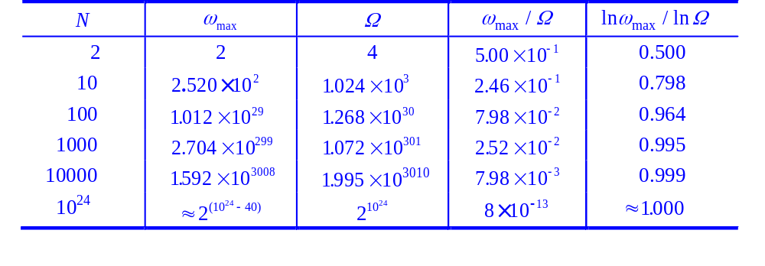
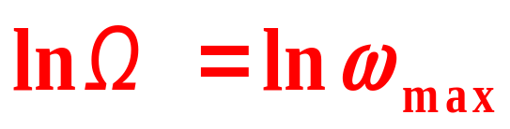
  12.4 The Most Probable Distribution
5. Maximum-Term Method
Corollary
For systems composed of a large amount of particles, the logarithm of the thermodynamic probability of a macroscopic state lnΩ can be replaced by that of the most probable distribution lnω_{max}

Slide 22
  12.4 The Most Probable Distribution
Scientific research methodology
Experimental
Macroscopic State
Postulates
Distributions
Methodology
General rules
Maximum-term
Microscopic State
Application

Slide 23
II. Statistical Distributions of Independent-Particle Systems
Bilingual Program
版权所有：华东理工大学物理化学教研室

Slide 24
Framework of the Chapter
II. Statistical Distributions of Independent- Particle Systems
12.5 Maxwell-Boltzmann Distribution
12.6 Molecular Partition Function

Slide 25
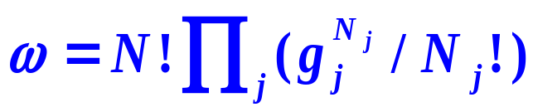
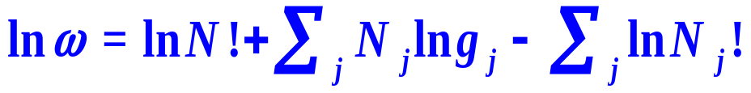

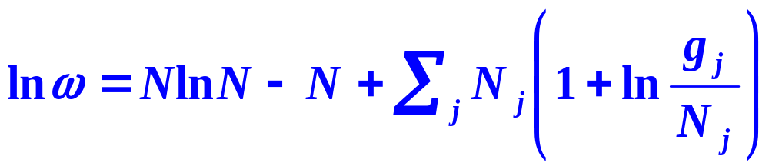
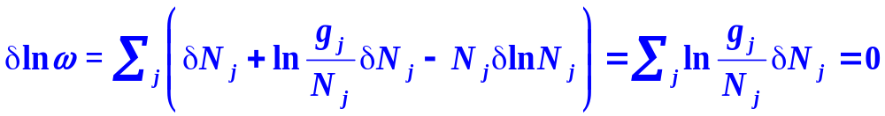
  12.5 Maxwell-Boltzmann Distribution
2. Derive the Maxwell-Boltzmann Distribution
(1) Find the Most Probable Distribution
Thermodynamic Probabilities of Distributions
Thermodynamic Probability of the Most Probable Distribution Is a Maximum

Slide 26
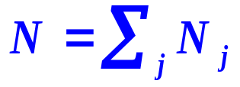
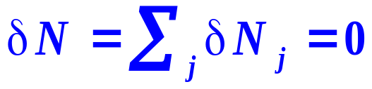
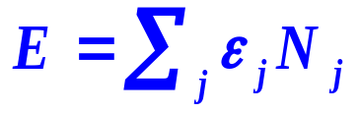
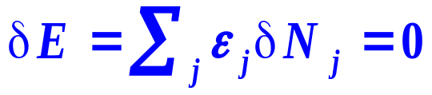
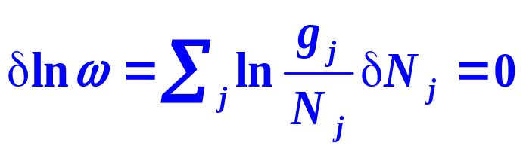
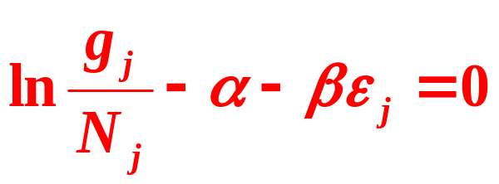
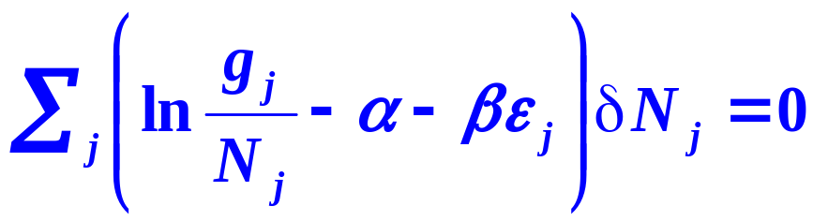

  12.5 Maxwell-Boltzmann Distribution
2. Derive the Maxwell-Boltzmann Distribution
(1) Find the Most Probable Distribution
Constraints
Conservation of particle
Conservation of energy
(2) Lagrange Multiplier Method

Slide 27
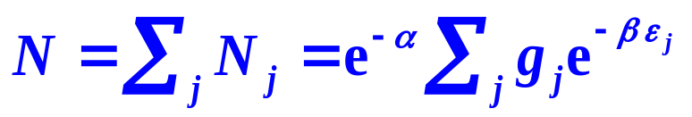
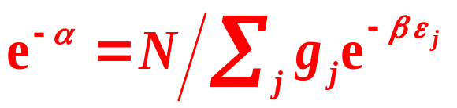
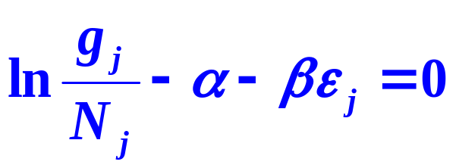
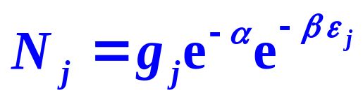
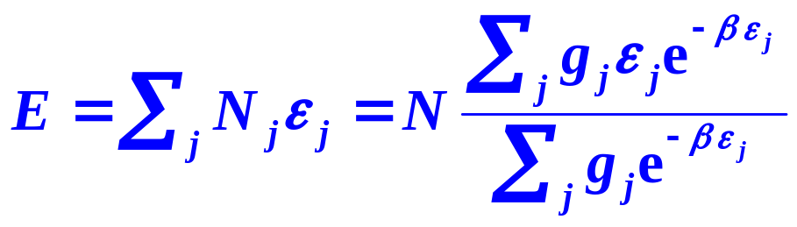
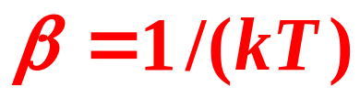
  12.5 Maxwell-Boltzmann Distribution
(3) Undetermined Multiplier α and β

Slide 28
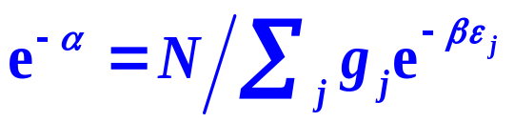
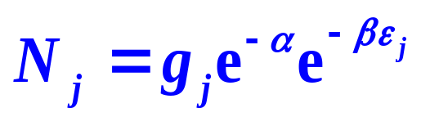

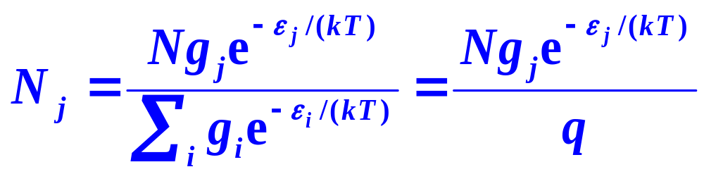
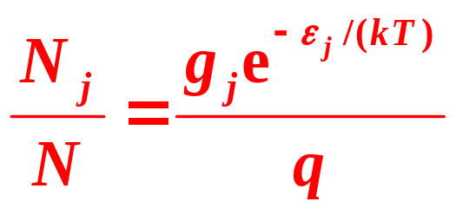

  12.5 Maxwell-Boltzmann Distribution
(4) Maxwell-Boltzmann Distribution
Boltzmann factor
molecular partition function

Slide 29
  12.5 Maxwell-Boltzmann Distribution
(5) Implications of the MB Distribution
The probability of particles in the energy level j
The lower the energy level and the larger Boltzmann factor, the larger the degeneracy, the higher probability of finding particles in that energy level will be.
The distribution is suitable for the independent-particle systems composed of classical particles but with quantized energies.

Slide 30





  12.5 Maxwell-Boltzmann Distribution
(6) Distributions in terms of Energy Levels and of Quantum States
In terms of Energy Levels
In terms of Quantum States
The quantum state is irrelevant to the concept of degeneracy,
For a system

Slide 31








  12.5 Maxwell-Boltzmann Distribution
Example
Suppose that HCl can be considered as a linear rigid rotator. Calculate the molecular distribution in terms of the rotational energy levels at 300K. (I_{HCl}=26.4×10⁻⁴⁸kg⋅m², h=0.66260755×10⁻³³J⋅s, k=13.80658×10⁻²⁴J⋅K⁻¹ )
Solution
0
1
3
6
1
2.71
3.80
1.54

Slide 32





  12.5 Maxwell-Boltzmann Distribution
Example
Calculate the molecular distribution of I₂ vapor in terms of the vibrational energy levels.
Solution

Slide 33








  12.6 Molecular Partition Function
1. Expressions for the Molecular Partition Function
Definition
or
Ground state energy level

Slide 34




  12.6 Molecular Partition Function
2. Factorial Characteristics of the Molecular Partition Functions
Neglecting the interactions among the degrees of freedom of various motions, the energy of a molecule
The molecular partition function of a molecule can then be expressed by multiplying together the molecular partition functions of various forms of motions.

